Slide 1
Creation & Automation – Central DB
GOVERNMENT OF TELANGANA
GROUND WATER DEPARTMENT
Historical data, MIS facility, Real time data dissemination – web publishing software, TSGWD website, data communication, mobile app

Slide 2
Groundwater Central Database
Creation of Central Database and Automatic Data Acquisition System
Development of Smart Phone Mobile Application
Upgradation of existing website with latest GIS & MIS technologies (content management)
Development of Performance Monitoring and Evaluation System (PMES) for internal tracking of work progress
Automatic generation and Publishing of various Ground Water Related GIS & MIS Reports
Maintenance of the System

Slide 3
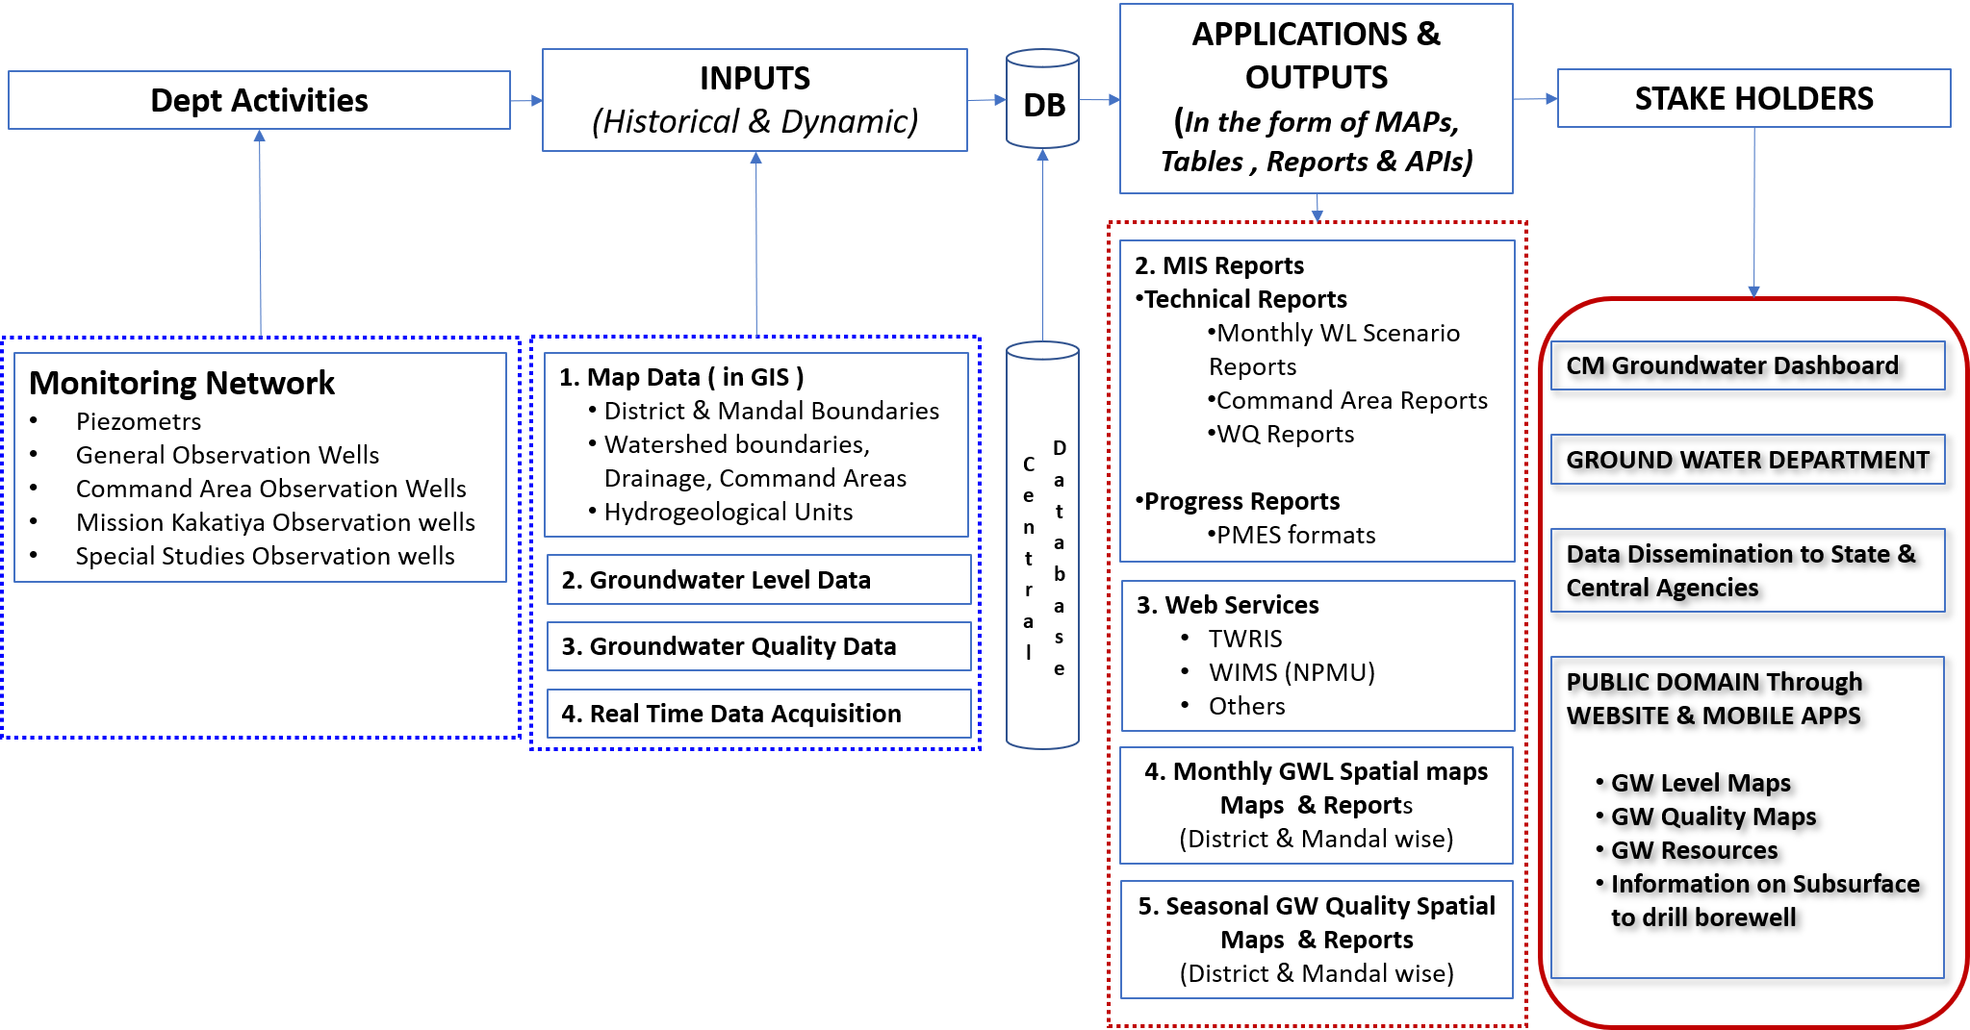
Flowchart of proposed activity development

Slide 4
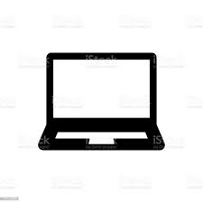
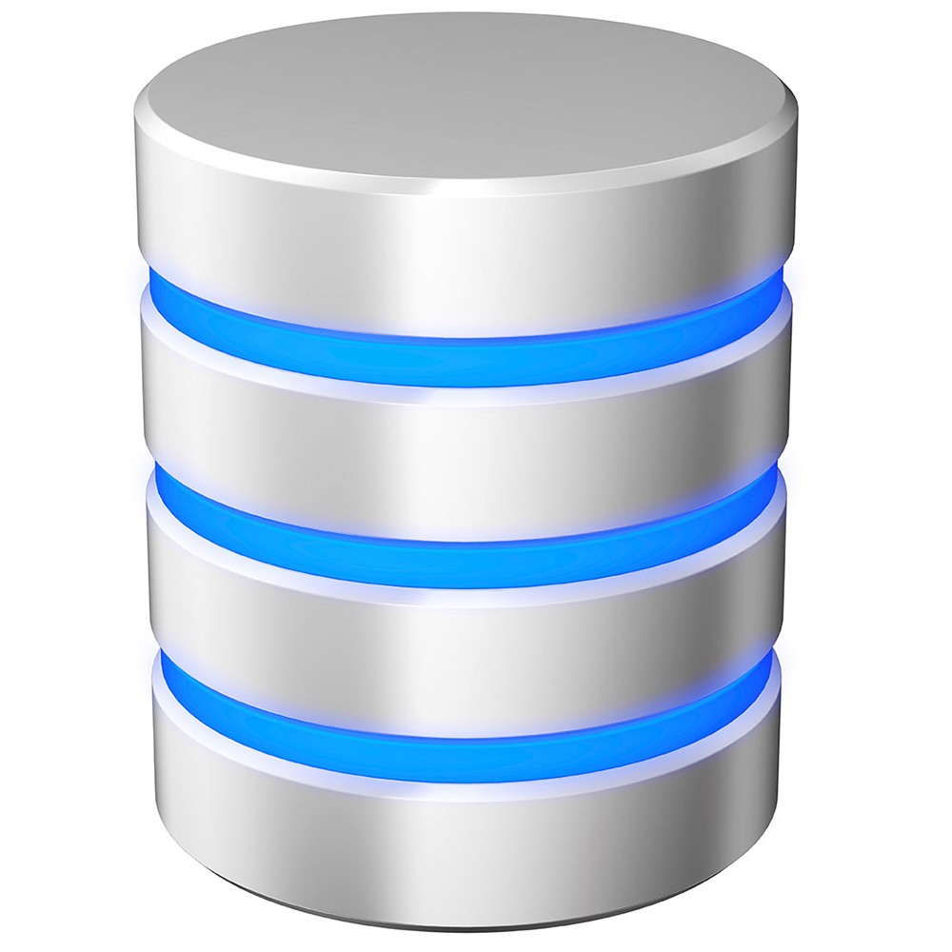
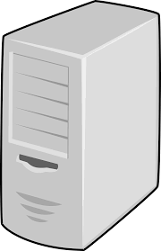
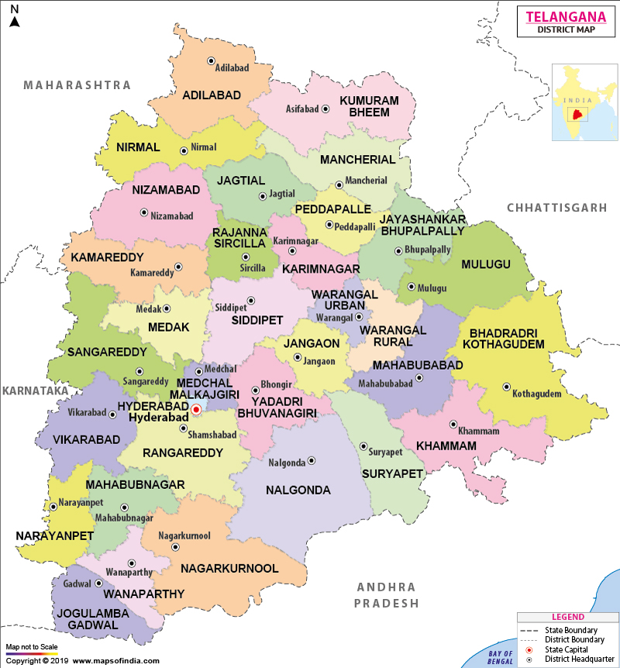
System Schematic – Centralised Groundwater database
VPN considered
DB Server
GRASP Data
JSON, All alerts
Internet
JSON, use mobile queue
Mobile data capture
Off-line near on-line
GIS Server
Application server
Currently single, no load balancer
Collated from Service Provider
User
Future Reporting &
Fulfilment server
DWLR Data
Reports, Dashboards, Analytics (Spatial too)

Slide 5
I. Upgradation of existing website with latest GIS & MIS technologies (content management)
Redesign and develop the home page as per the department requirement and add animations and static data content to the website for better look and feel.
Upgrade the existing website with latest technologies to make it more dynamic and responsive.
Integration of real time data from other services and telemetry sensors
Design and Development of GIS & MIS modules to publish data
Design and Development of mini Ground Water Geo Portal
Design and Development of Security module for admin users logins
Reports integration from other sites and publishing them in website
Important circulars and letters
GIS server : ARCGIS Enterprises ? (Requested NIC)

Slide 6
II. Development of Performance Monitoring and Evaluation System (PMES) for internal tracking of work progress
Development of internal MIS and Workflow management System for tracking of Performance Monitoring and Evaluation System ( PMES)
Role Based Login at District Level and State Level
Development of ~ 40 Input and output forms for tracking various work progress of the department
Ability to consolidate district level reports to state level
Development of smart charts and Key Performance Indicators (KPI) to visualize individual district work progress status and state level work progress status.

Slide 7
Central DB & Automatic DAS
Data Integration from Monitoring of Water Levels (Real Time/Near Real Time / Historic) (using GRASP, on-line interface)
i. Piezometers (PZ)
ii. General Observation Wells (GOB)
iii. Command Area Observation Wells (COB)
iv. Other studies Observation wells
vi. Stream flow check points
vii. Field investigations – Essentially forms to be used on mobile devices – around 8-10
• Exploration
• Site selection for wells
• RWHS and AR structures
• Special studies/Purpose Driven Studies (PDS) •
Ground Water Quality data integration (Real Time/Near Real Time/ Historic)
Asset management – Limited to recording of assets, contracts
Other Ground Water Related Information –

Slide 8
Automatic generation and Publishing of various Ground Water Related GIS & MIS Reports
MIS Reports
Technical Reports
Monthly WL Scenario Reports
Command Area Reports
WQ Reports
GEC Reports
Spatial Map Reports
Real Time Ground Water Levels
State & Mandal wise
Project wise
Seasonal Ground Water Levels - State & Mandal Wise
Monthly Ground Water Levels
Fluctuation Maps with Respect to Start of the season and previous year
Information on Subsurface (Groundwater Atlas)
Progress Reports (intranet-department)
PMES formats (intranet-department)
Data sharing on Request (with online registration facility)
Important circulars and letters (public & intranet-department)
Integration of GEC Reports
Ground Water resources as per GEC o District wise o Mandal wise o Watershed wise (GEC)
Monthly change in Gw storage o District wise o Mandal wise o Watershed wise
File Tracking & Management

Slide 9
Landing Page

Slide 10
Well Information

Slide 11
Ground water scenario

Slide 12
Real time Monitoring

Slide 13
Water quality

Slide 14
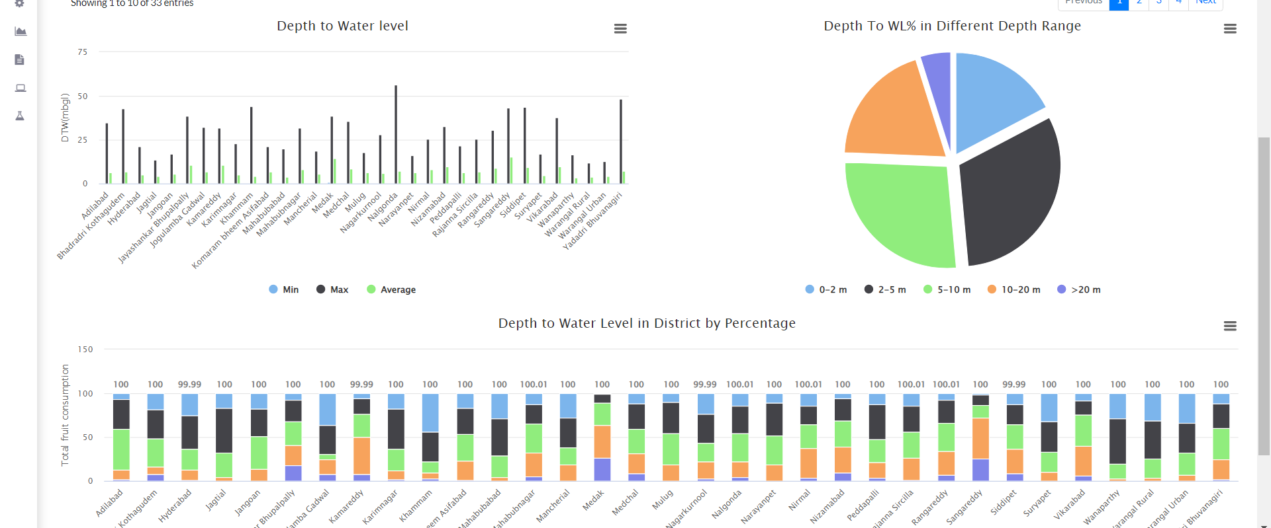
Manual Water level

Slide 15
Groundwater Resources Assessment

Slide 16
Rainfall

Slide 17
Dashboard

Slide 18
Hydrograph

Slide 19
Hydrograph Yearly

Slide 20
Well Information

Slide 21
Data availability

Slide 22
Water level monthly data

Slide 23
Water level fluctuation summary

Slide 24
Trend

Slide 25
Compare WL & WQ

Slide 26
Water quality listing

Slide 27
WL in given range

Slide 28
WQ box whisker

Slide 29
Water quality fluctuation summary

Slide 30
WL and WQ entry interface

Slide 31
Smart Phone Mobile Application
Manual Data collection
Ground Water Levels (PZs, COB, GOB, MK, Special studies etc.)
Stream flow check points
Ground Water Quality (in-situ parameters)
Data Dissemination
Location Specific Ground Water Related information to Citizens and Department Users
Includes citizen interface (require registration ?)

Slide 32
Server Configuration
Sample: 8vCPU, 32 GB RAM, 2000 GB SSD, 1500 GB Bandwidth, 1 Public Static IP, 2*GigE vNIC, OS as desired (Windows, Ubuntu)
App Server
16/32GB RAM
4/8 Core
NFS/Block ? RAID Level ? Any SSD
DB Server
32GB RAM
4/8 Core
GIS Server
32GB RAM
8 Core
No HA or DR envisaged at present, may require large document storage

Slide 33
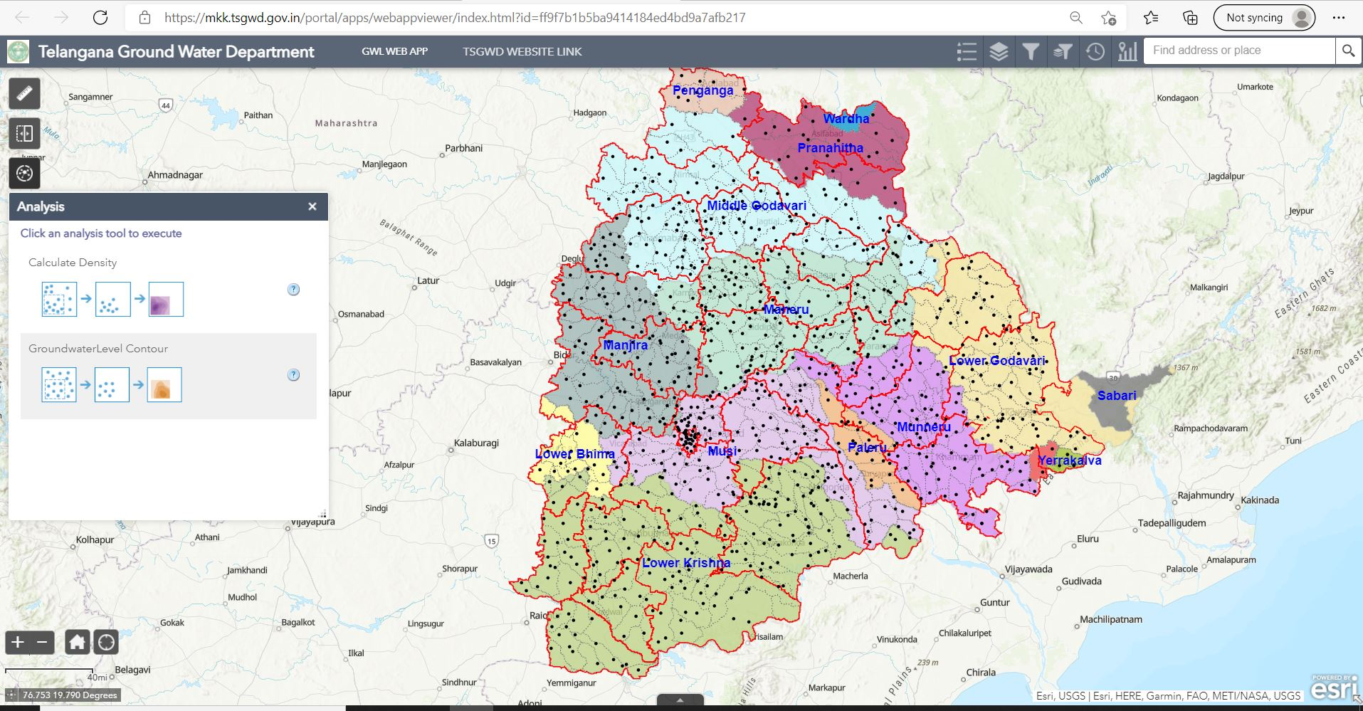

Slide 34
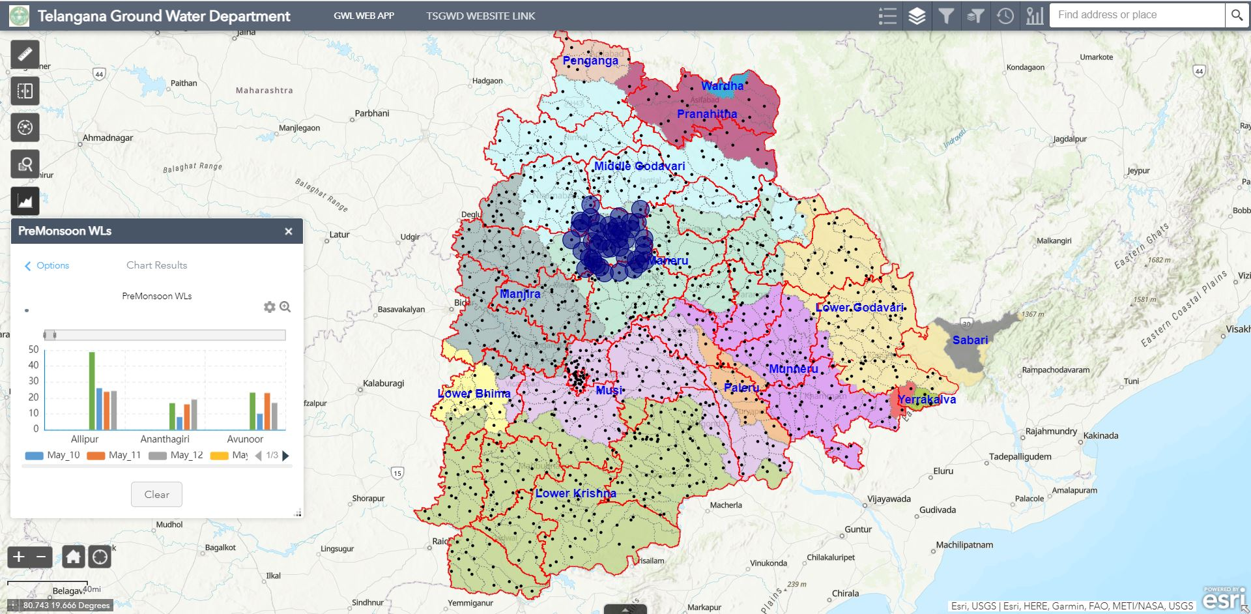

Slide 35
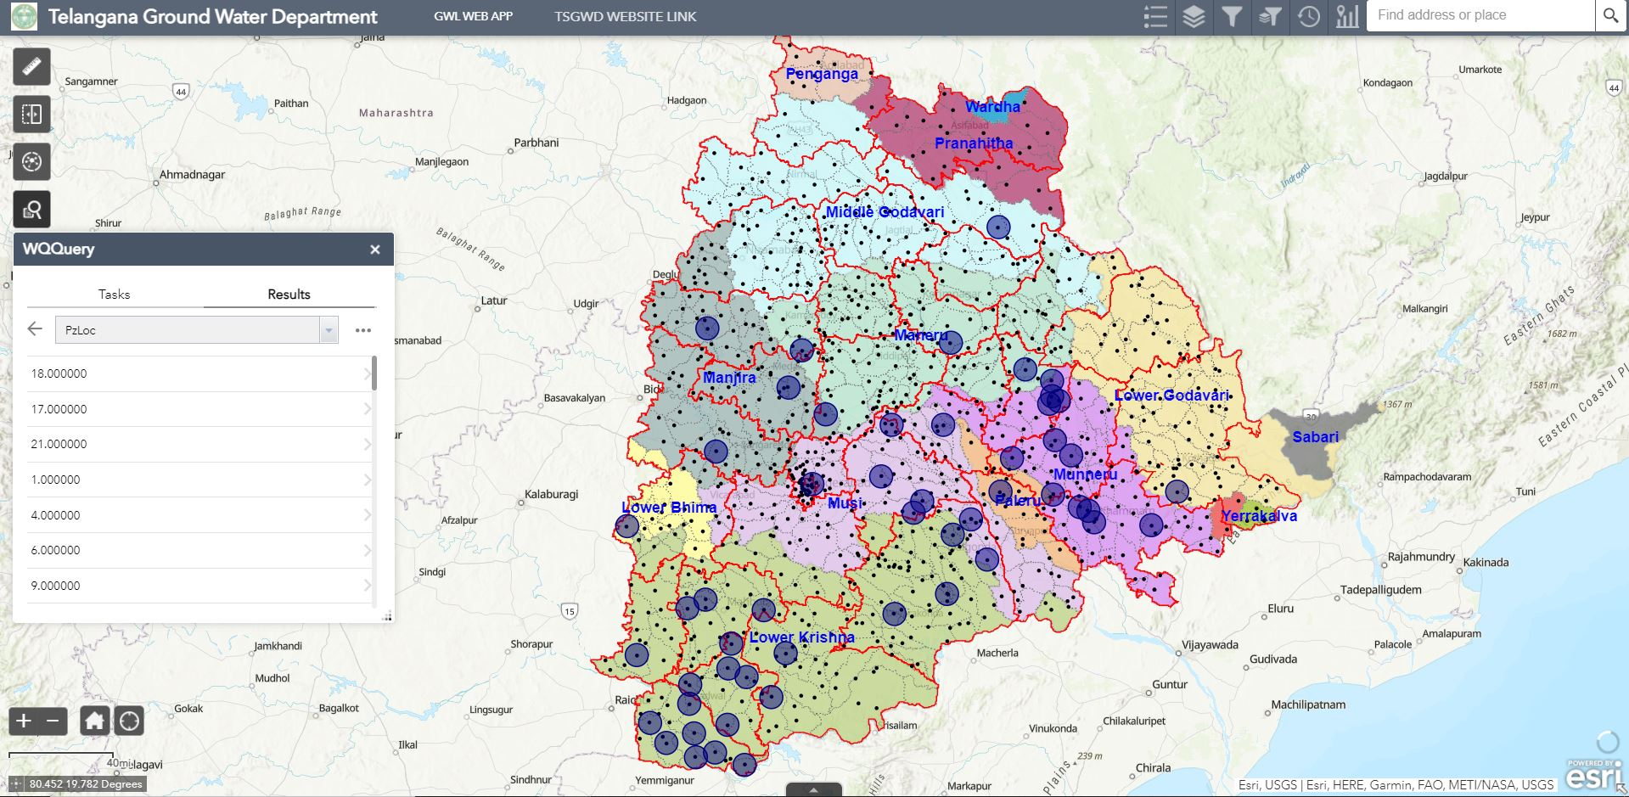

Slide 36
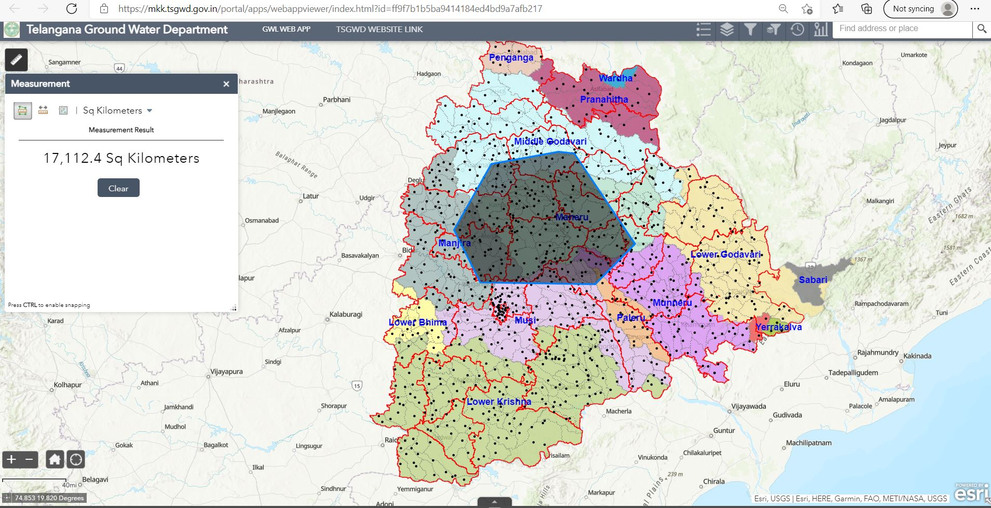

Slide 37
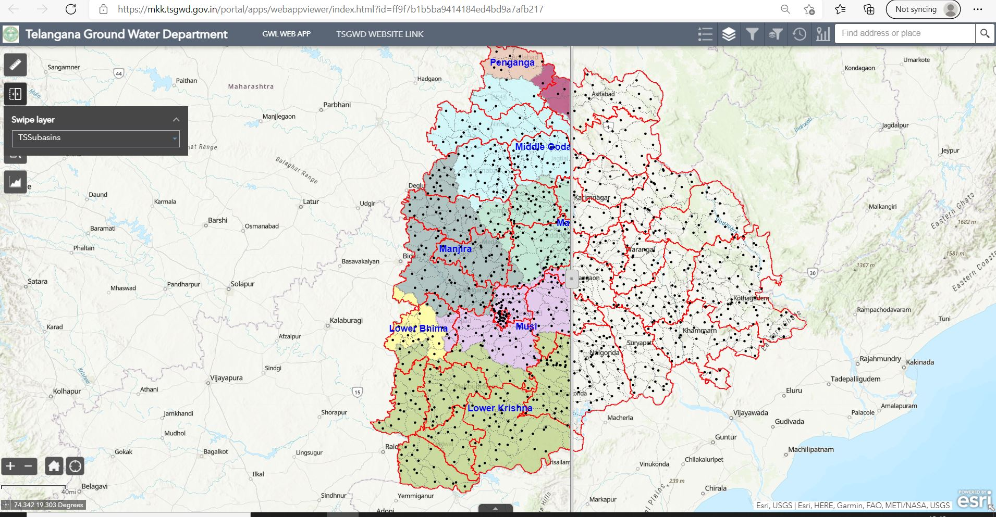

Slide 38
Mobile App
Telangana/

Slide 39
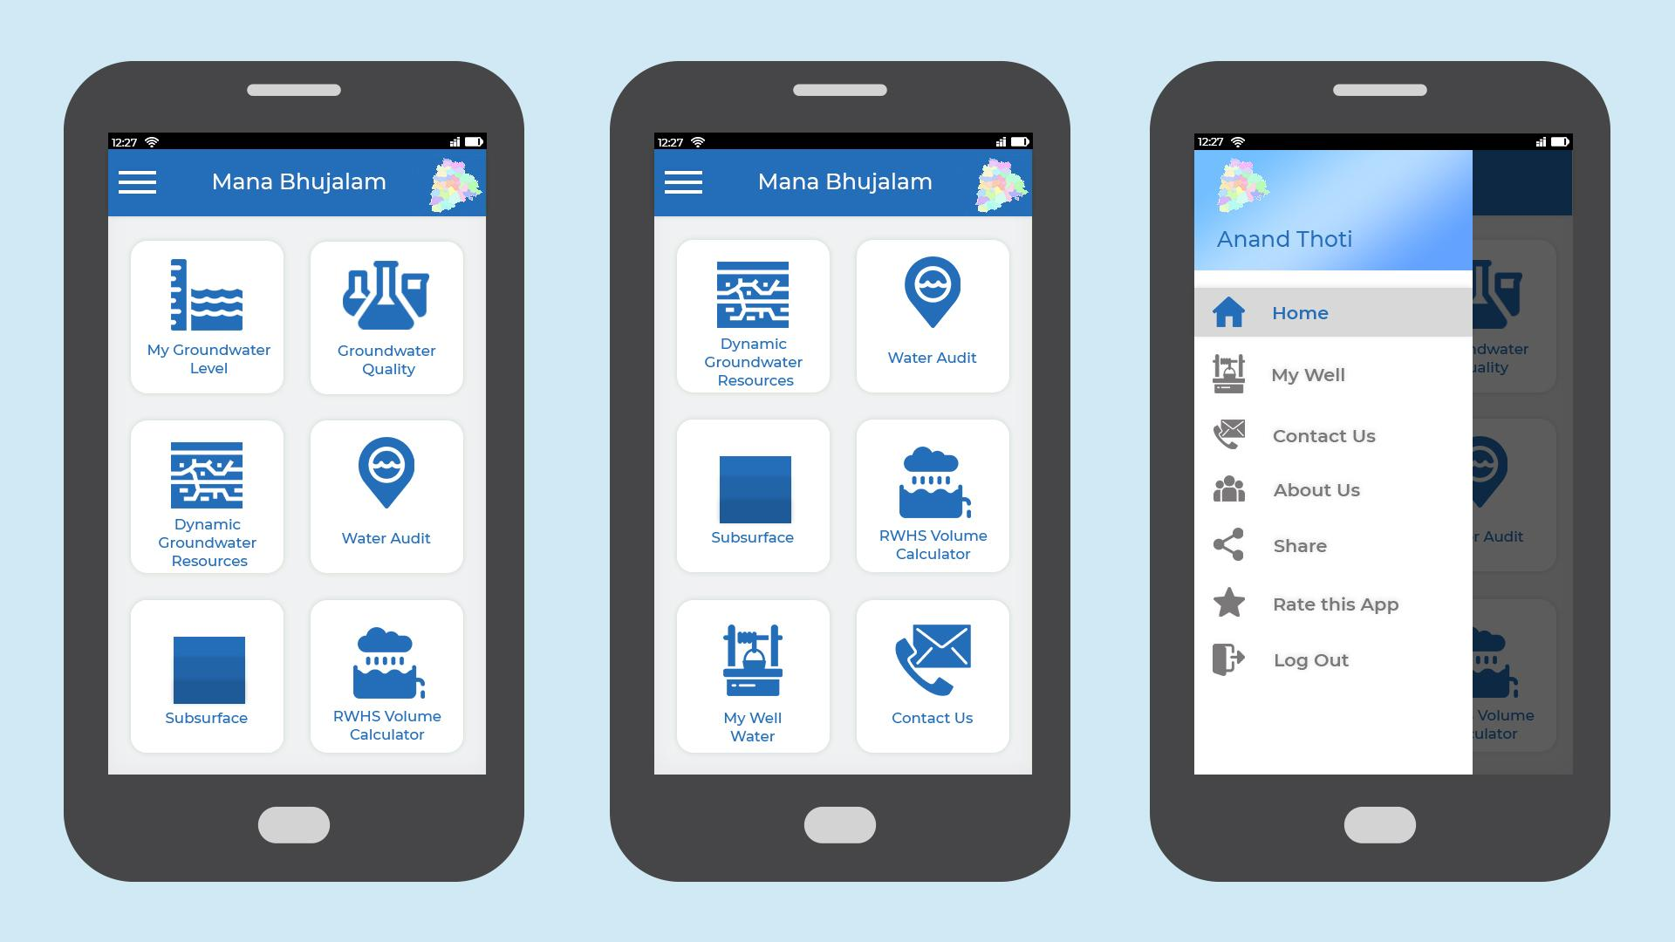

Slide 40
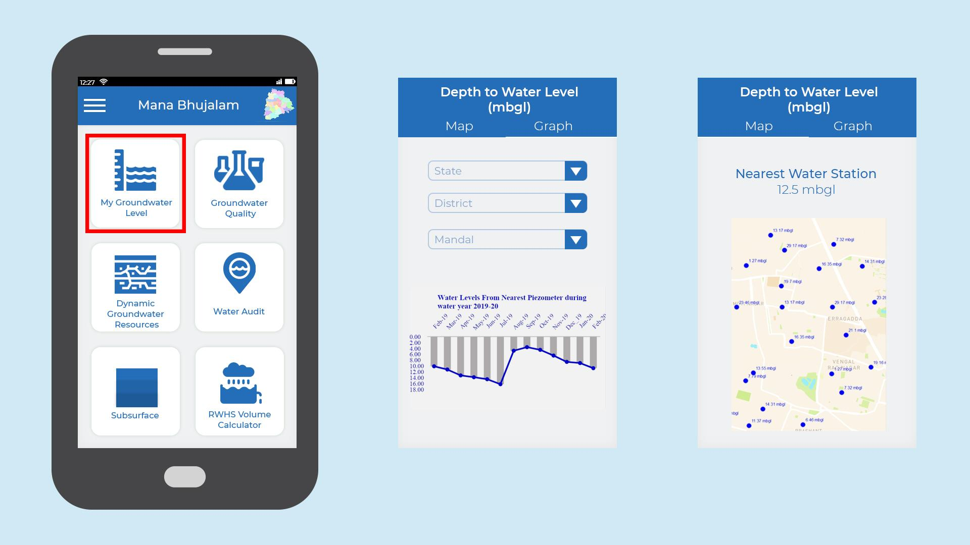
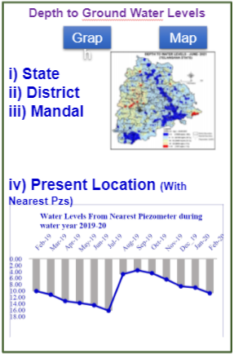

Slide 41
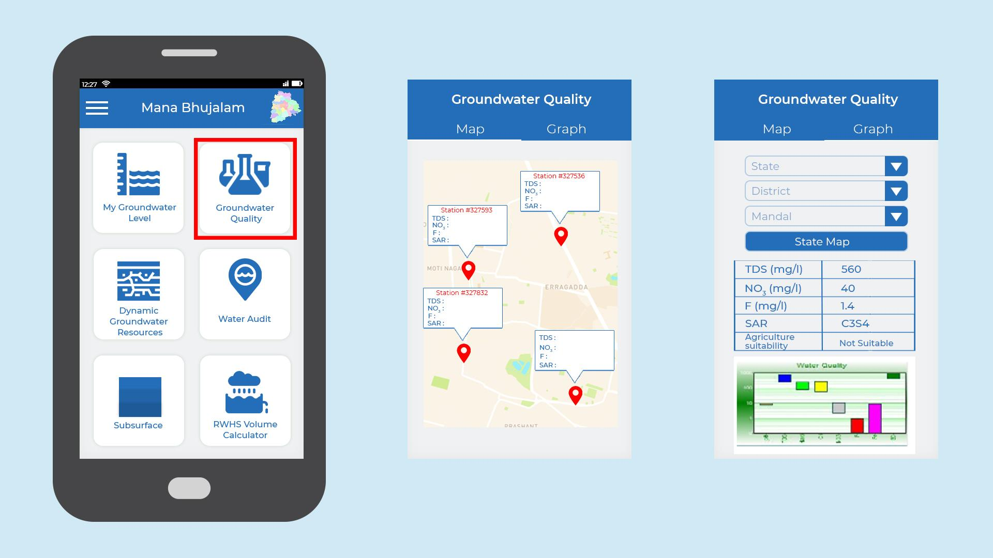
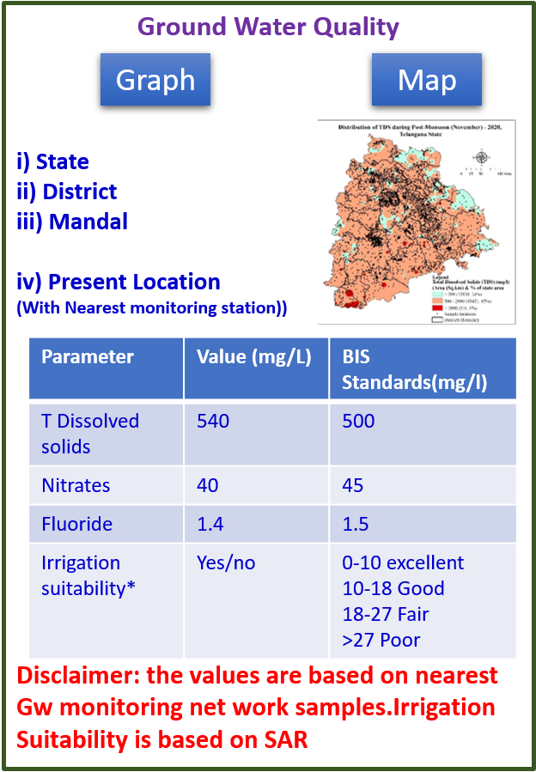

Slide 42
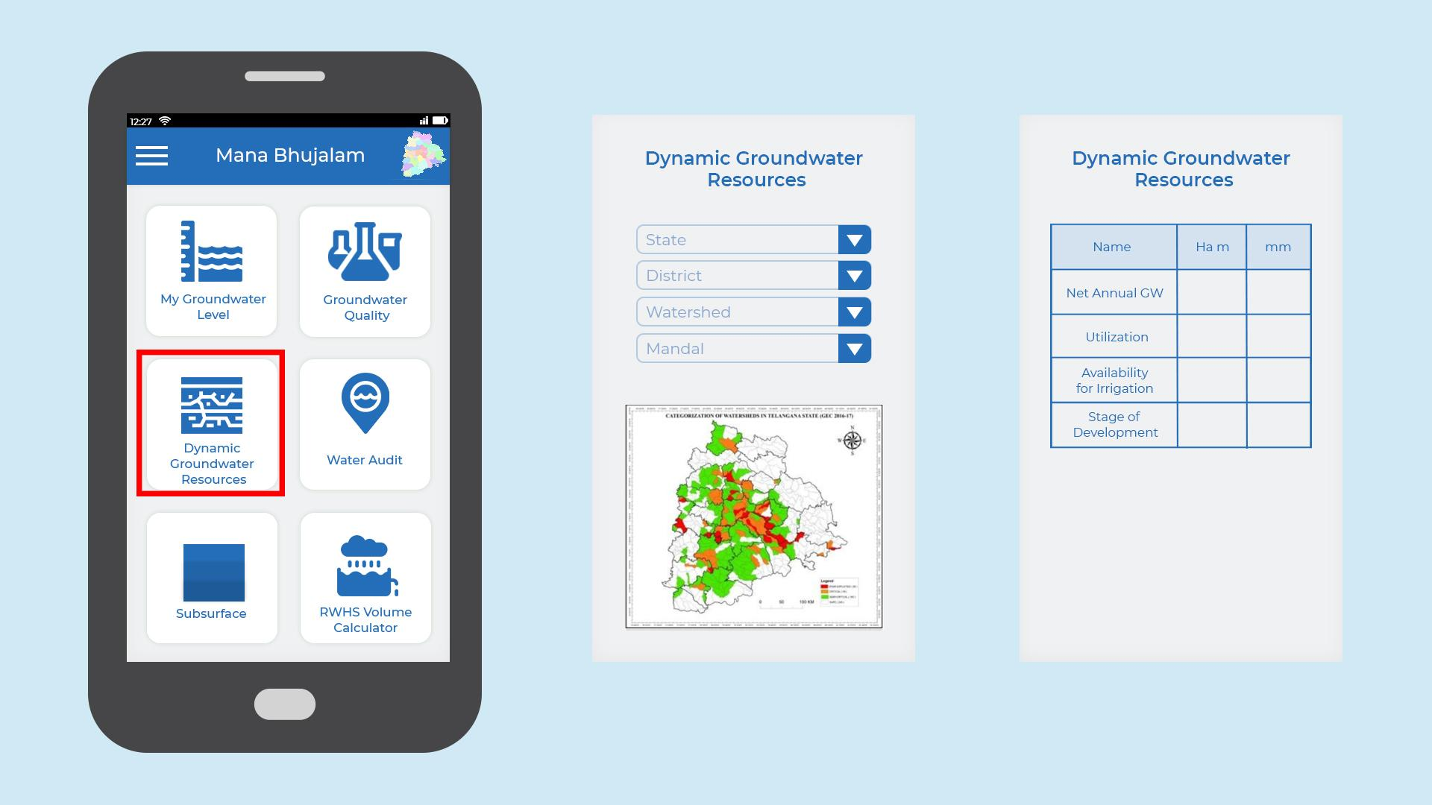
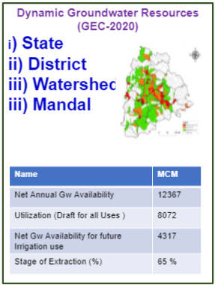
March2020
MCM
15118
7676
7451
51%
MCM: Million Cubic Metres

Slide 43
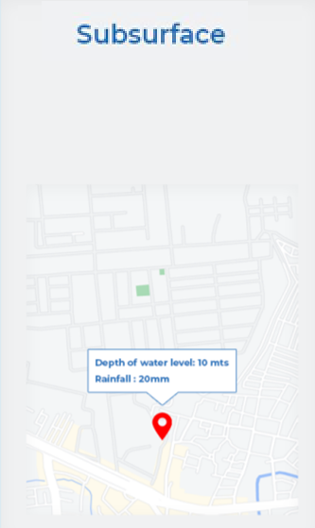
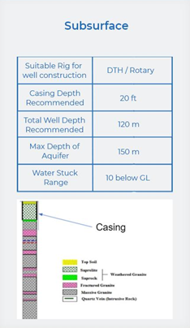
Suitable Rig for well Construction | DTH / Rotary
Casing Depth Recommended | 6 - 10 m
Total Well Depth Recommended | 100 - 120 m
Water Struck Range | 10 - 15 m
Disclaimer : The Information is based on the available data with the Department

Slide 44
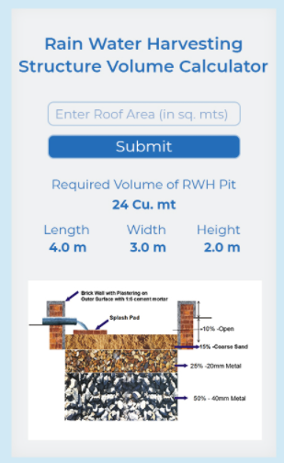
Note: Dimensions of pit may vary as per space available. Precautions to be taken near bldg. foundations etc.,

Slide 45
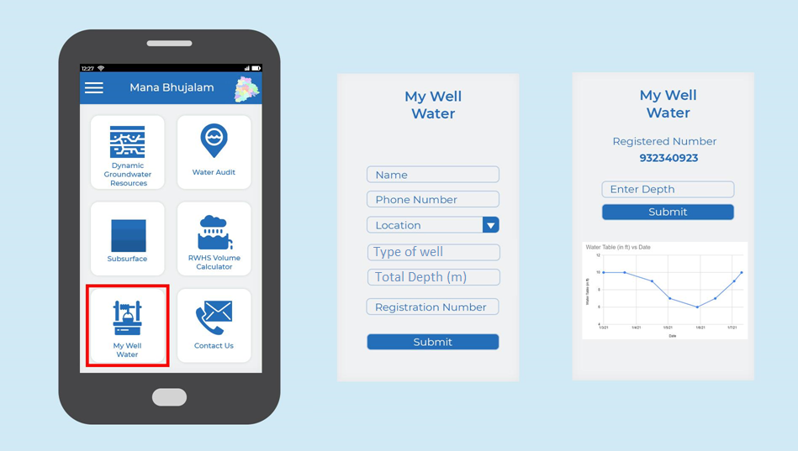

Slide 46
Thank You
…for Sustainable Groundwater through Technology

